Slide 1
Medical History Blockchain Portability
By Gopalakrishnan Kumar, MTech IIT-Bombay,
Freelance Data Science Consultant
LinkedIn: Profile Link : https://www.linkedin.com/in/gopalakrishnankumar-a73301110/
Github:https://github.com/Gopal21236/
Kaggle URL- https://www.kaggle.com/gopalkk2

Slide 2
Google Colab URL
https://colab.research.google.com/drive/1_jM5z0_bg8YXP6RL_PU574EhnAIAuoxq?usp=sharing

Slide 3
Introduction
Healthcare systems across the world face a critical challenge: medical data fragmentation. Patient medical histories are typically stored in isolated databases owned by individual hospitals, clinics, or laboratories. This siloed approach leads to inefficiencies such as repeated diagnostic tests, incomplete medical histories, data integrity risks, and limited patient control over personal health information.
Blockchain technology offers a decentralized and immutable data architecture that can fundamentally transform how medical records are stored, shared, and verified. This project explores how a blockchain-based system can enable secure, portable, and tamper-proof medical history management, placing patients at the center of data ownership while ensuring trust among healthcare providers.

Slide 4
Objective of the Project
The primary objective of this project is to design and simulate a medical history portability framework using blockchain principles, with the following goals:
Enable secure storage of medical records in an immutable ledger
Ensure medical data integrity and tamper detection
Support seamless portability of patient records across providers
Provide transparency and auditability for regulatory compliance
Demonstrate analytics on blockchain-stored medical data

Slide 5
Problem Statement
Traditional healthcare data systems suffer from several limitations:
Medical records are fragmented across providers
Data sharing relies on manual or centralized systems
Patients lack direct ownership or control over their data
Unauthorized modification of records is difficult to detect
Auditing and compliance require significant overhead
These challenges increase operational costs, reduce quality of care, and erode trust between stakeholders.

Slide 6
Solution Overview
This project proposes a blockchain-based medical record ledger, where each medical record is stored as a block containing:
Patient ID
Medical data (diagnosis, medication)
Timestamp
Cryptographic hash
Hash pointer to the previous block
By chaining records cryptographically, the system ensures that any attempt to alter historical data invalidates the entire chain, making tampering immediately detectable.

Slide 7
Blockchain Architecture
5.1 Block Structure
Each block consists of:
Index
Timestamp
Patient identifier
Medical record details
Previous block hash
Current block hash (SHA-256)
5.2 Genesis Block
The blockchain begins with a genesis block, serving as the initial trusted anchor.

Slide 8
Blockchain Architecture
5.3 Chain Validation
A validation function recalculates hashes and verifies hash pointers to ensure ledger integrity

Slide 9
Data Simulation and Implementation
The blockchain was implemented using Python, simulating real-world medical record entries for multiple patients. Each new medical event (diagnosis or medication update) creates a new block, preserving historical versions rather than overwriting data.
This design supports longitudinal medical history tracking, which is critical for chronic disease management and continuity of care.

Slide 10
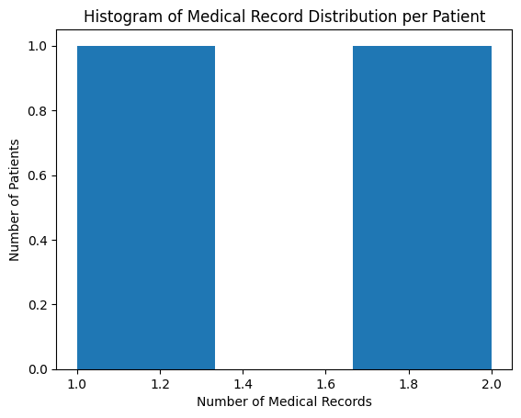
Data Visualization

Slide 11
Visualization and Analytics
Histogram Analysis
The histogram was used to analyze the distribution of medical records per patient. This visualization helps understand how medical data accumulates over time and identifies variability in patient medical histories. Patients with higher record counts may represent chronic conditions requiring long-term care, while lower counts may indicate episodic treatment. This insight is valuable for capacity planning and longitudinal health monitoring.

Slide 12
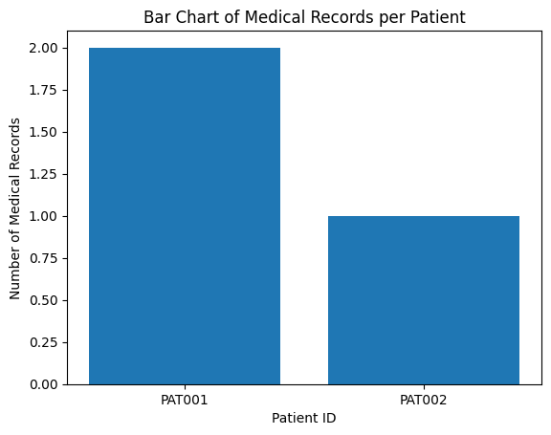
Data Visualization

Slide 13
Visualization and Analytics
Bar Chart Analysis
The bar chart provides a clear comparison of total medical records across patients. By presenting patient-wise record volume, healthcare providers can quickly identify individuals with extensive medical histories. This supports efficient clinical prioritization and resource allocation while maintaining a patient-centric view of healthcare data.

Slide 14
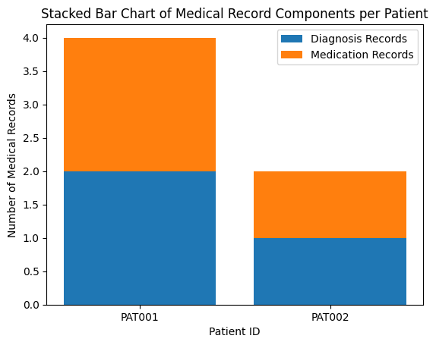
Data Visualization

Slide 15
Visualization and Analytics
Stacked Bar Chart Analysis
The stacked bar chart decomposes medical records into diagnosis and medication components. This layered visualization improves explainability by showing not just the volume of data but also its composition. Such transparency is essential in healthcare analytics, enabling clinicians and administrators to understand the nature of stored medical information at a granular level.

Slide 16
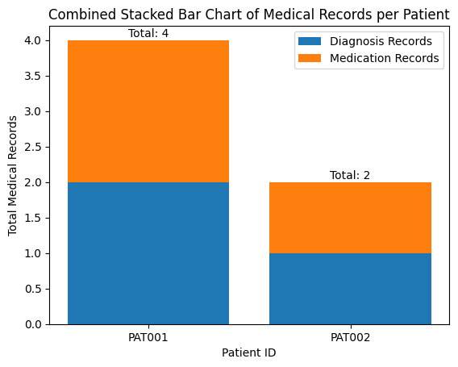
Data Visualization

Slide 17
Data Visualization
Combined Stacked Bar Chart Analysis
The combined stacked bar chart integrates total medical record volume with component-level breakdown in a single executive-friendly view. Annotated totals enhance interpretability, making the visualization suitable for high-level decision-making. This chart is particularly effective for communicating blockchain data insights to non-technical stakeholders.

Slide 18
Key Insights
Medical records stored on blockchain are immutable and
verifiable
Patient-centric data models support seamless portability
Component-level analytics improve transparency
Blockchain naturally supports longitudinal healthcare data
Visual analytics enhance trust and interpretability

Slide 19
Business Impact
From a business and healthcare operations perspective, this solution:
Reduces duplicate diagnostic procedures
Improves continuity of patient care
Enhances trust between providers and patients
Supports regulatory compliance through audit trails
Enables scalable health data analytics
Healthcare providers benefit from faster access to reliable data, while patients gain ownership and control over their medical histories.

Slide 20
Limitations
Uses simulated data rather than real EHR systems
Does not include encryption of sensitive fields
Access control and consent management are not implemented
Scalability and interoperability are not fully addressed

Slide 21
Future Enhancements
Potential extensions of this project include:
Smart contracts for consent-based access control
Encryption of sensitive medical attributes
Integration with hospital EHR systems
Scalability optimization for large datasets
Role-based access for doctors, insurers, and regulators

Slide 22
Conclusion
This project demonstrates how blockchain technology can be effectively applied to healthcare data management. By ensuring immutability, transparency, and portability, blockchain enables a secure and patient-centric medical record system. The integration of analytics further enhances the value of the solution by transforming raw medical records into actionable insights.

